Slide 1
Data-Oriented Design and C++
Mike Acton Engine Director, Insomniac Games @mike_acton

Slide 2
A bit of background…

Slide 3
What does an “Engine” team do?

Slide 4
Runtime systems
e.g.
Rendering
Animation and gestures
Streaming
Cinematics
VFX
Post-FX
Navigation
Localization
…many, many more!

Slide 5
Development tools
e.g.
Level creation
Lighting
Material editing
VFX creation
Animation/state machine editing
Visual scripting
Scene painting
Cinematics creation
…many, many more!

Slide 6
What’s important to us?

Slide 7
What’s important to us?
Hard deadlines

Slide 8
What’s important to us?
Hard deadlines
Soft realtime performance requirements (Soft=33ms)

Slide 9
What’s important to us?
Hard deadlines
Soft realtime performance requirements (Soft=33ms)
Usability

Slide 10
What’s important to us?
Hard deadlines
Soft realtime performance requirements (Soft=33ms)
Usability
Performance

Slide 11
What’s important to us?
Hard deadlines
Soft realtime performance requirements (Soft=33ms)
Usability
Performance
Maintenance

Slide 12
What’s important to us?
Hard deadlines
Soft realtime performance requirements (Soft=33ms)
Usability
Performance
Maintenance
Debugability

Slide 13
What languages do we use…?

Slide 14
What languages do we use…?
C
C++
Asm
Perl
Javascript
C#

Slide 15
What languages do we use…?
C
C++ ← ~70%
Asm
Perl
Javascript
C#

Slide 16
What languages do we use…?
C
C++ ← ~70%
Asm
Perl
Javascript
C#
Pixel shaders, vertex shaders, geometry shaders, compute shaders, …

Slide 17
We don’t make games for Mars but…

Slide 18
How are games like the Mars rovers?

Slide 19
How are games like the Mars rovers?
Exceptions

Slide 20
How are games like the Mars rovers?
Exceptions
Templates

Slide 21
How are games like the Mars rovers?
Exceptions
Templates
Iostream

Slide 22
How are games like the Mars rovers?
Exceptions
Templates
Iostream
Multiple inheritance

Slide 23
How are games like the Mars rovers?
Exceptions
Templates
Iostream
Multiple inheritance
Operator overloading

Slide 24
How are games like the Mars rovers?
Exceptions
Templates
Iostream
Multiple inheritance
Operator overloading
RTTI

Slide 25
How are games like the Mars rovers?
No STL

Slide 26
How are games like the Mars rovers?
No STL
Custom allocators (lots)

Slide 27
How are games like the Mars rovers?
No STL
Custom allocators (lots)
Custom debugging tools

Slide 28
Is data-oriented even a thing…?

Slide 29
Data-Oriented Design Principles
The purpose of all programs, and all parts of those programs, is to transform data from one form to another.

Slide 30
Data-Oriented Design Principles
If you don’t understand the data you don’t understand the problem.

Slide 31
Data-Oriented Design Principles
Conversely, understand the problem by understanding the data.

Slide 32
Data-Oriented Design Principles
Different problems require different solutions.

Slide 33
Data-Oriented Design Principles
If you have different data, you have a different problem.

Slide 34
Data-Oriented Design Principles
If you don’t understand the cost of solving the problem, you don’t understand the problem.

Slide 35
Data-Oriented Design Principles
If you don’t understand the hardware, you can’t reason about the cost of solving the problem.

Slide 36
Data-Oriented Design Principles
Everything is a data problem. Including usability, maintenance, debug-ability, etc. Everything.

Slide 37
Data-Oriented Design Principles
Solving problems you probably don’t have creates more problems you definitely do.

Slide 38
Data-Oriented Design Principles
Latency and throughput are only the same in sequential systems.

Slide 39
Data-Oriented Design Principles
Latency and throughput are only the same in sequential systems.

Slide 40
Data-Oriented Design Principles
Rule of thumb: Where there is one, there are many. Try looking on the time axis.

Slide 41
Data-Oriented Design Principles
Rule of thumb: The more context you have, the better you can make the solution. Don’t throw away data you need.

Slide 42
Data-Oriented Design Principles
Rule of thumb: NUMA extends to I/O and pre-built data all the way back through time to original source creation.

Slide 43
Data-Oriented Design Principles
Software does not run in a magic fairy aether powered by the fevered dreams of CS PhDs.

Slide 44
Is data-oriented even a thing…?
…certainly not new ideas.
…more of a reminder of first principles.

Slide 45
…but it is a response to the culture of C++

Slide 46
…but it is a response to the culture of C++
…and The Three Big Lies it has engendered

Slide 47
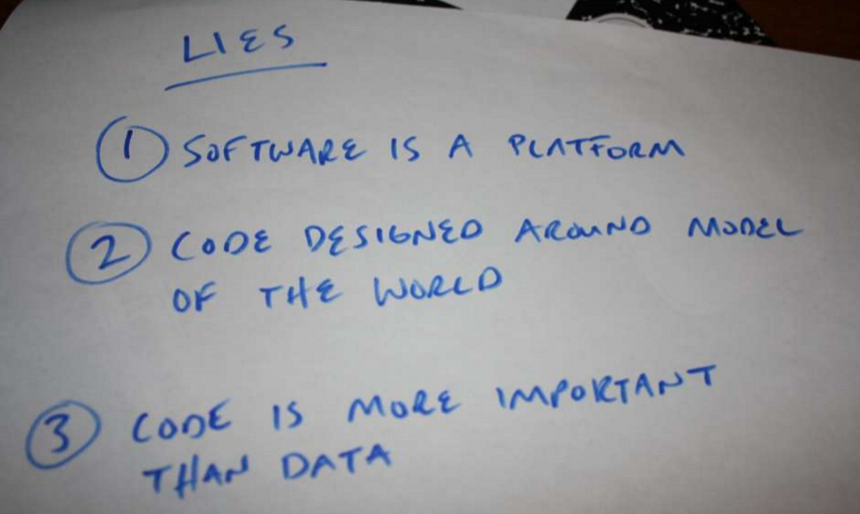

Slide 48
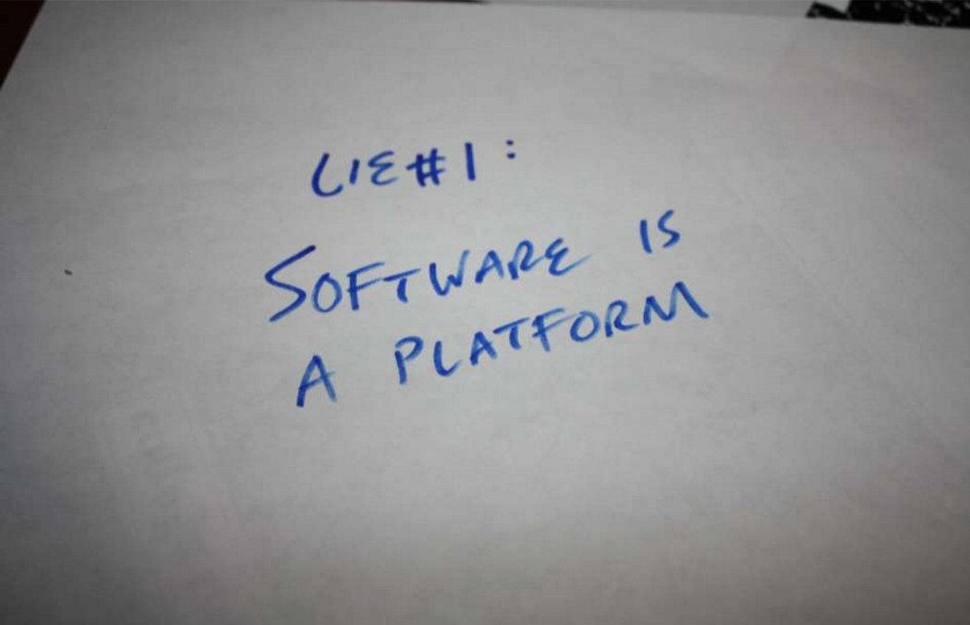

Slide 49
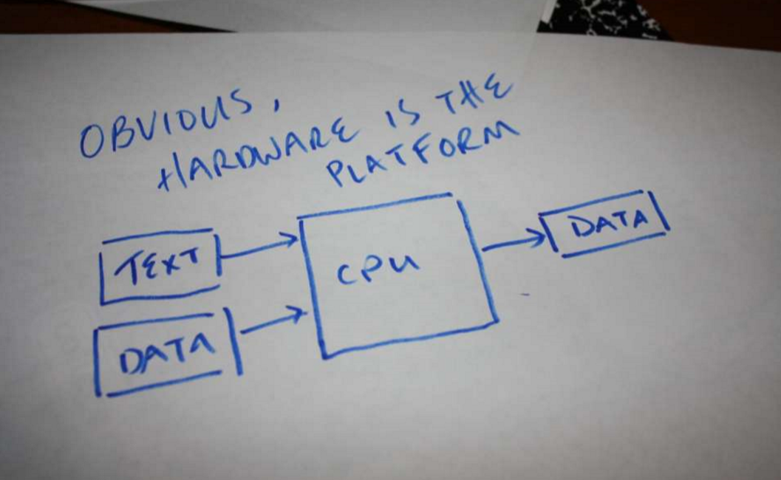

Slide 50
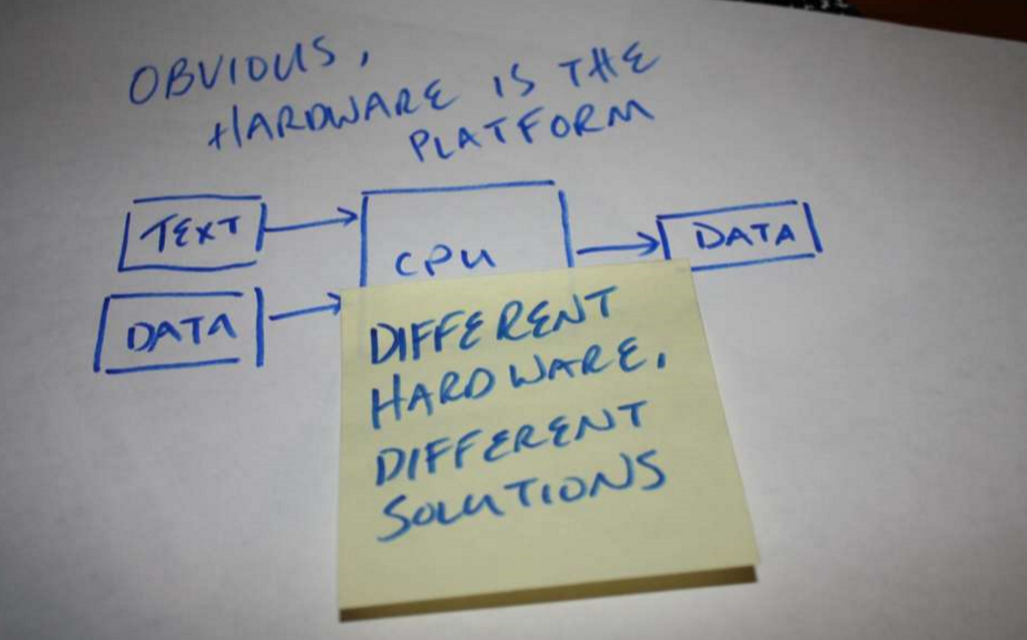

Slide 51
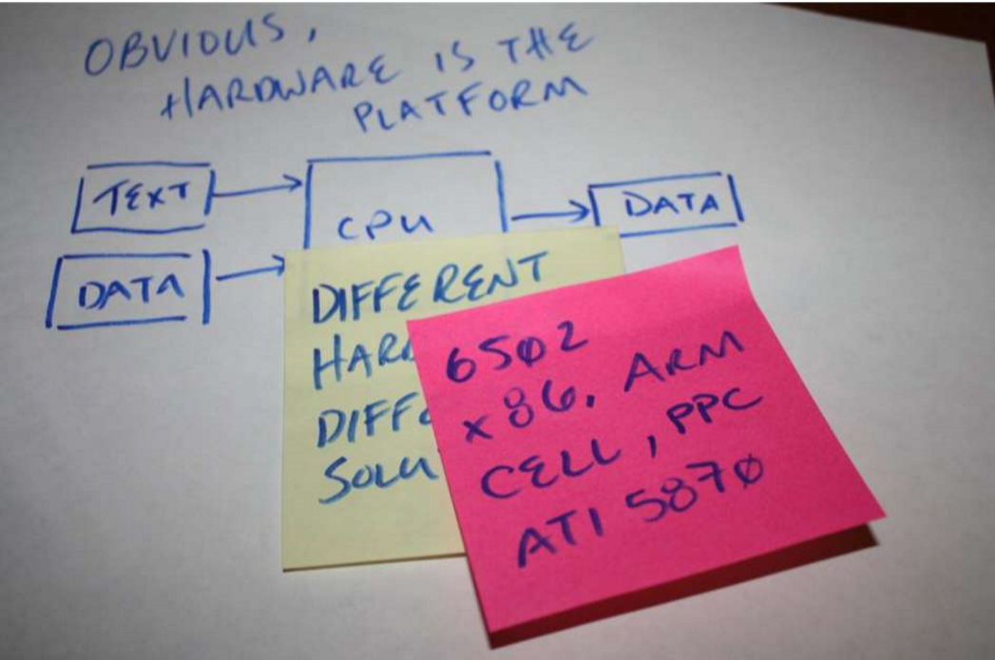

Slide 52
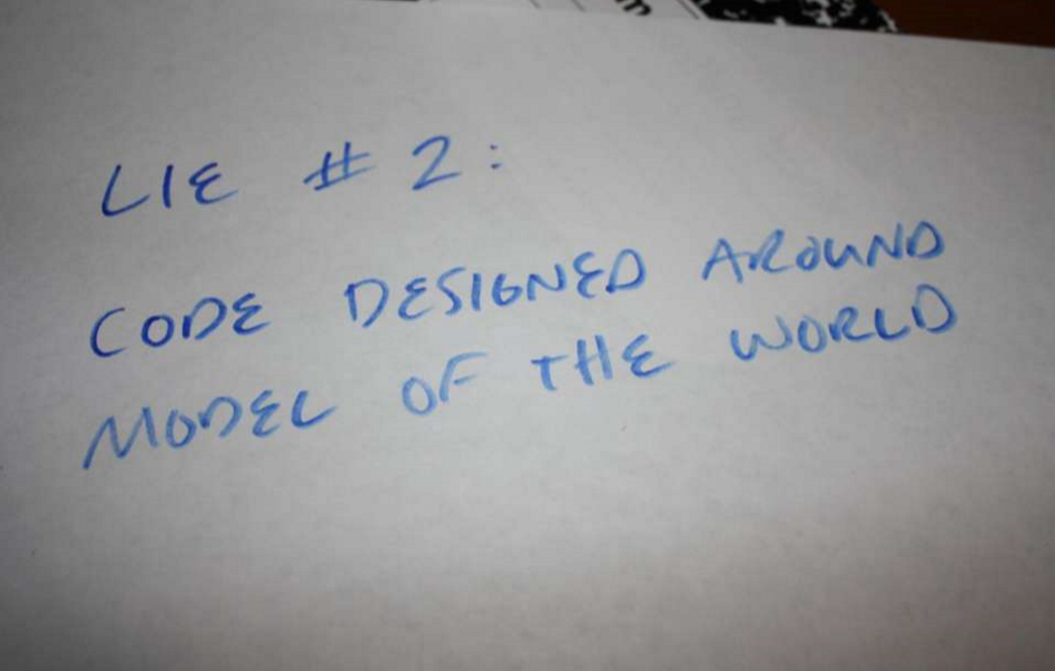

Slide 53
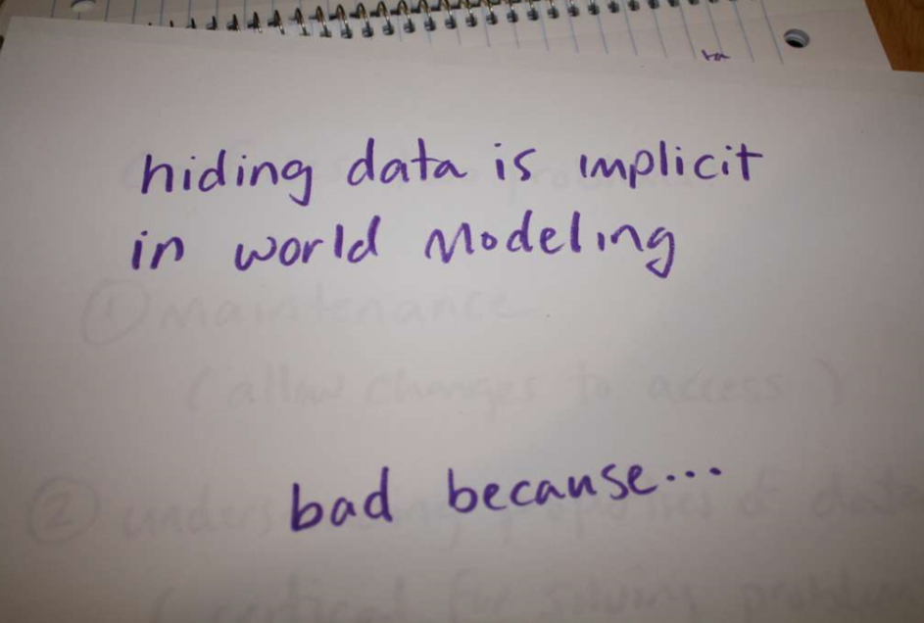

Slide 54
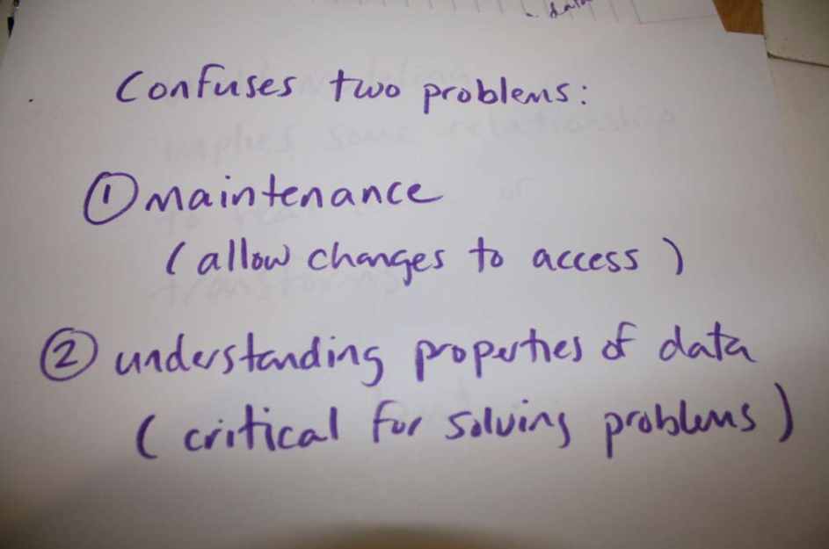

Slide 55
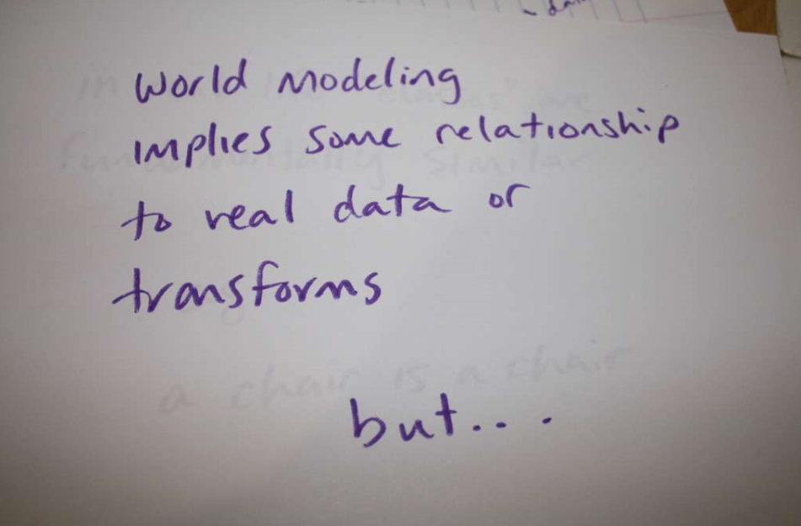

Slide 56
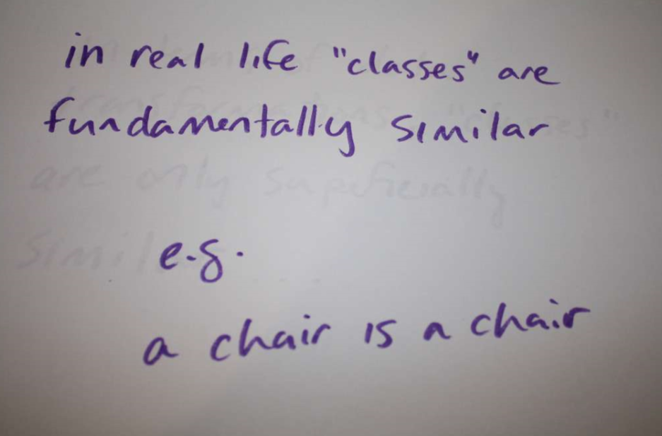

Slide 57
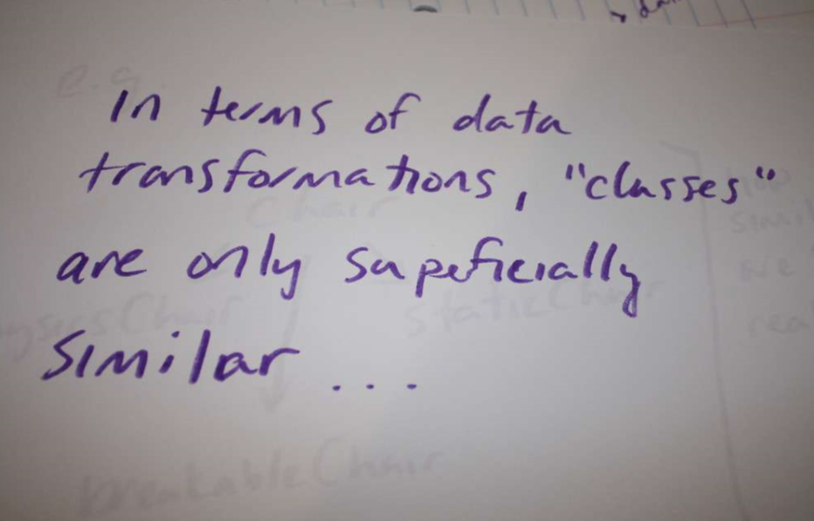

Slide 58
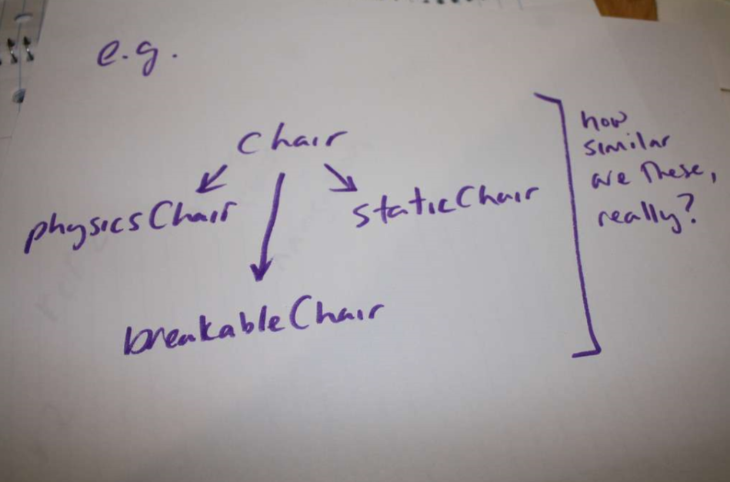

Slide 59
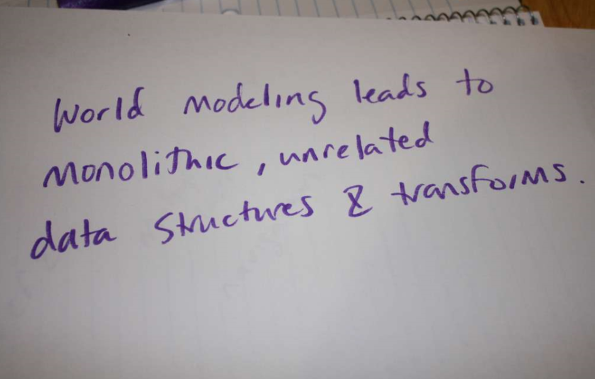

Slide 60
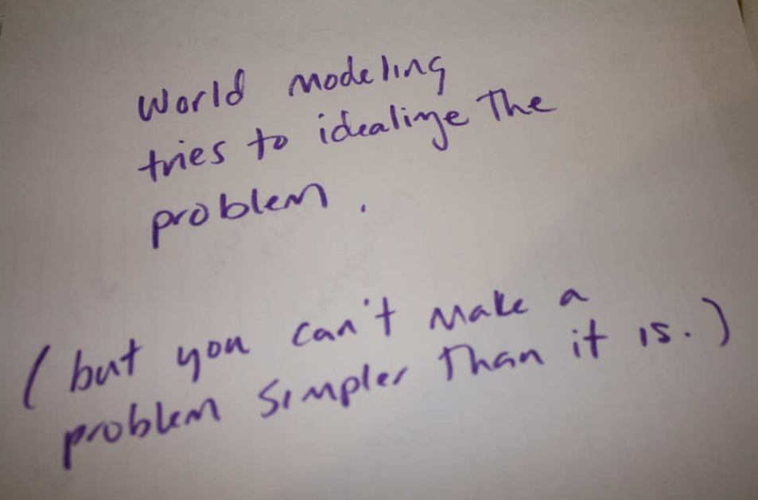

Slide 61
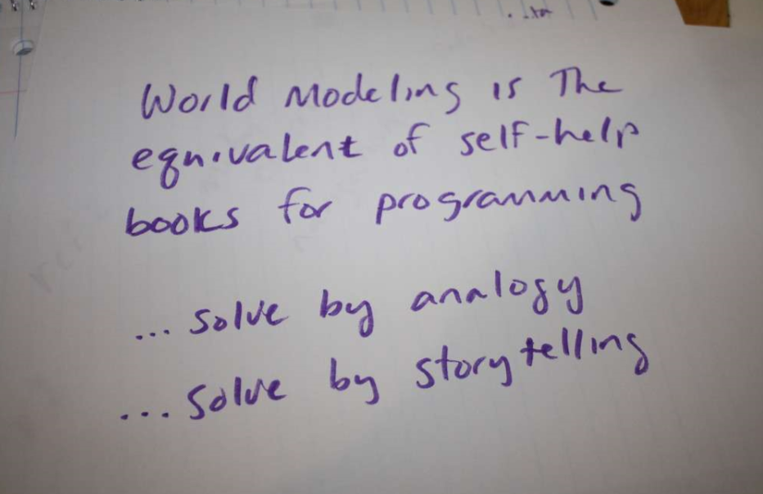

Slide 62
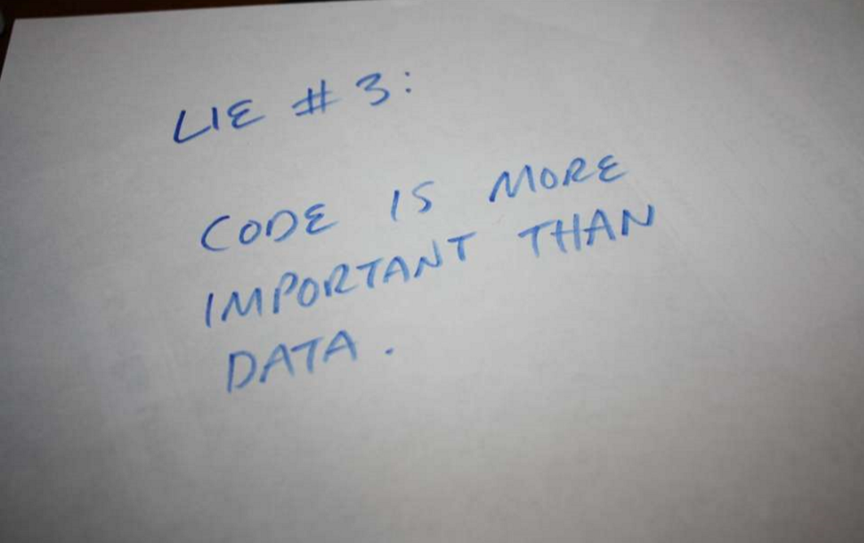

Slide 63
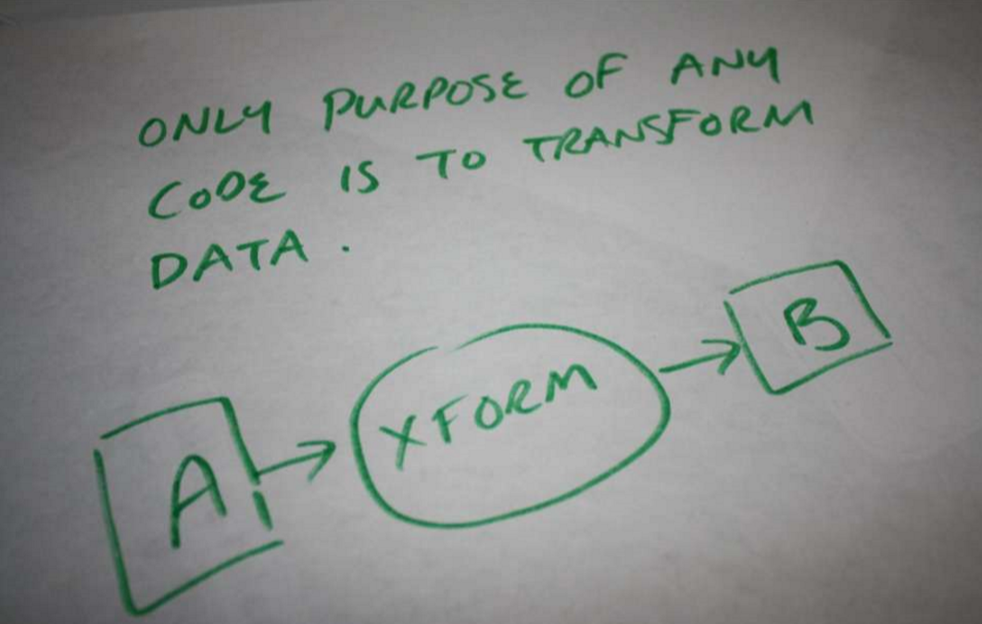

Slide 64
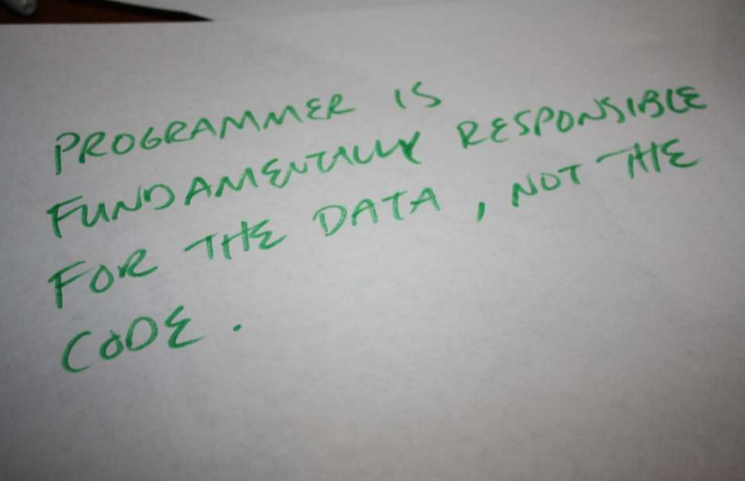
i.e. Programmer’s job is NOT to write code;
Programmer’s job is to solve (data transformation) problems

Slide 65
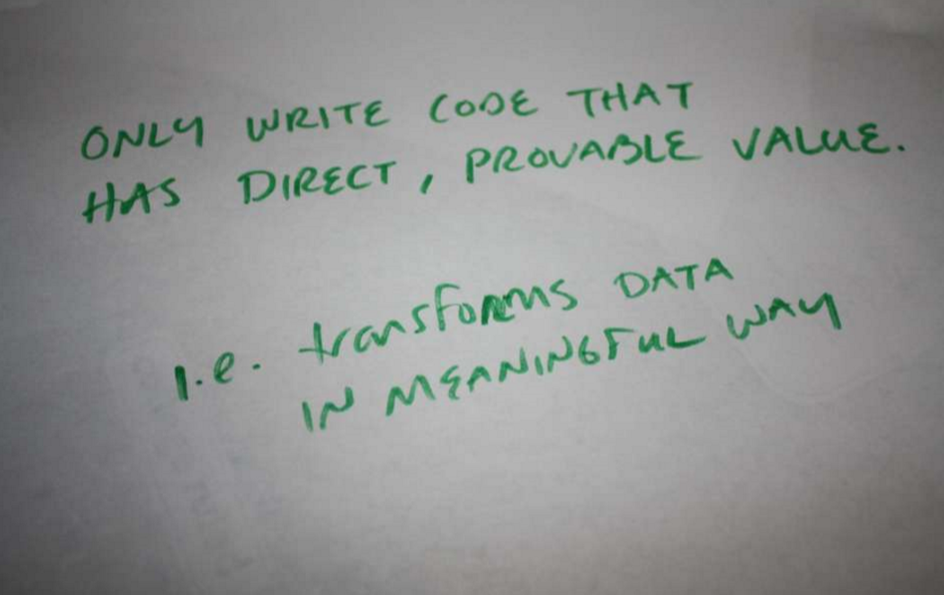

Slide 66
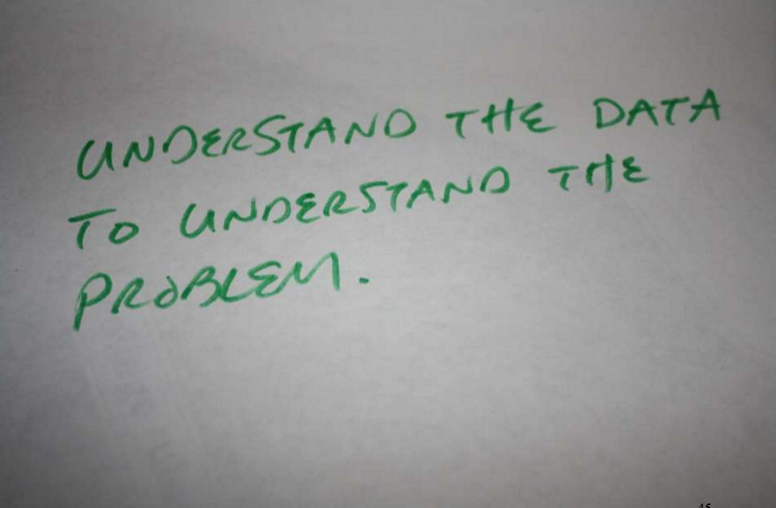

Slide 67
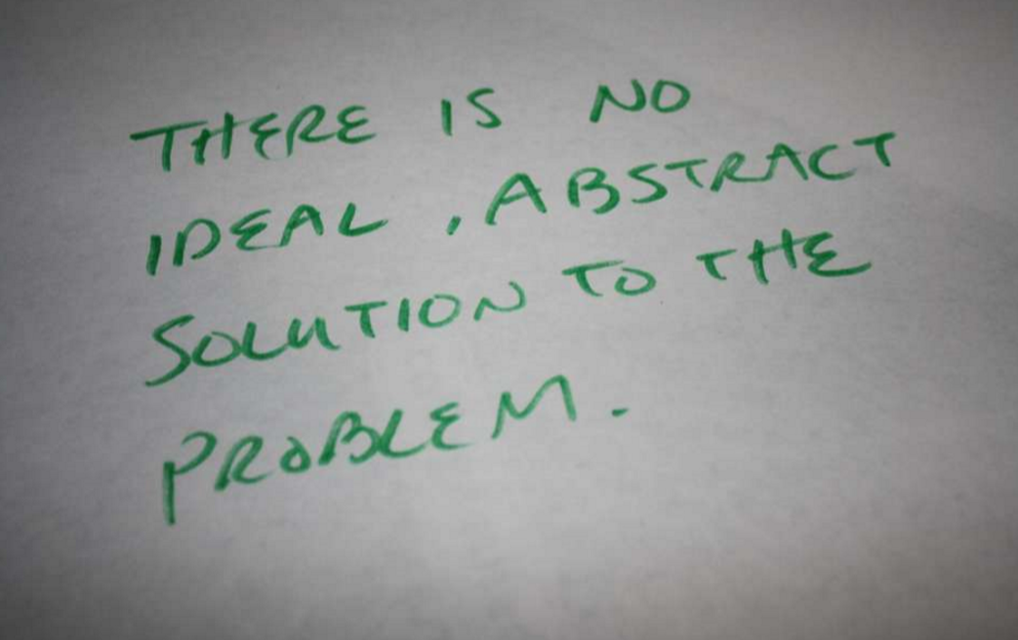

Slide 68
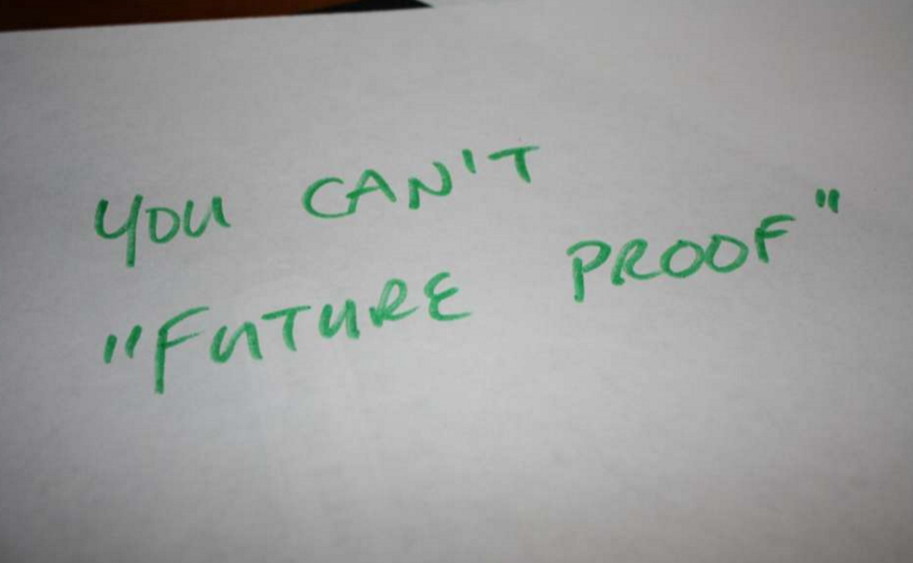

Slide 70
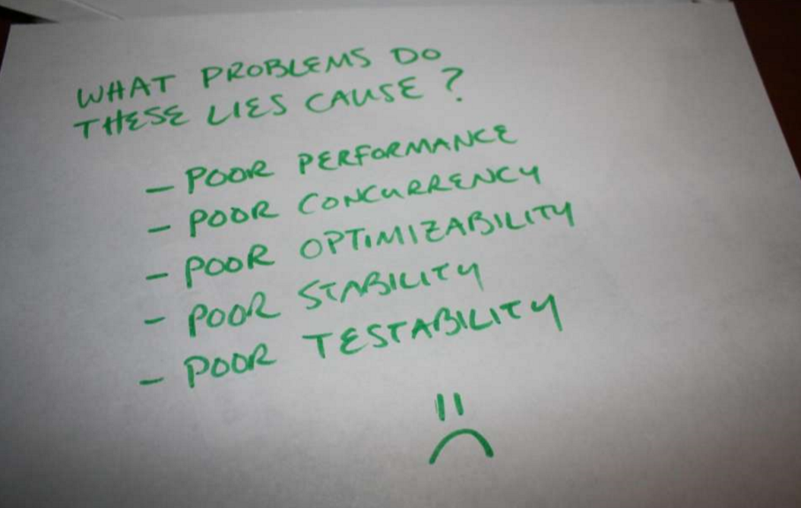

Slide 71
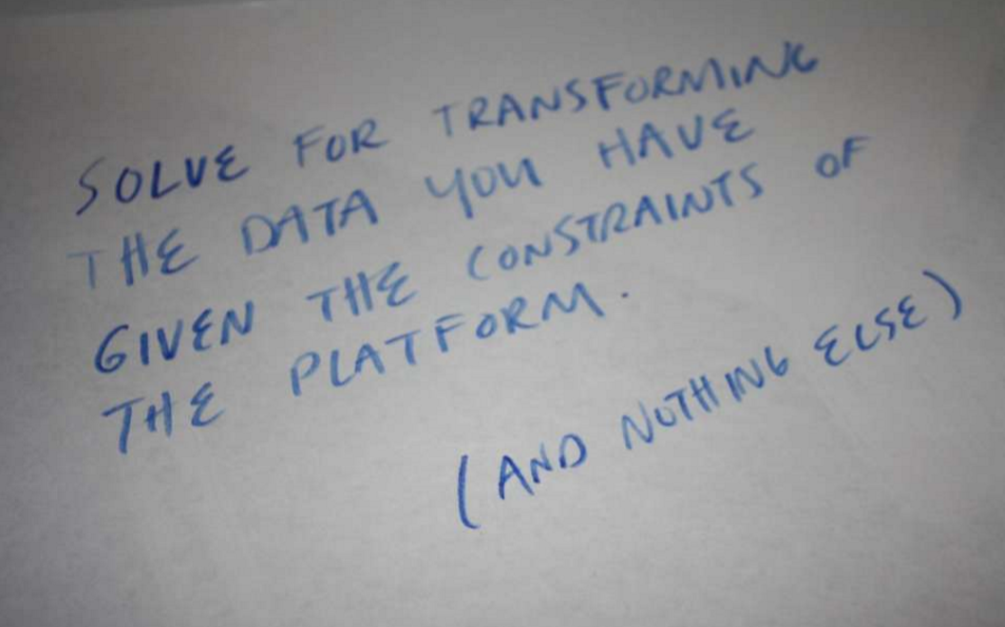

Slide 72
A simple example…

Slide 73
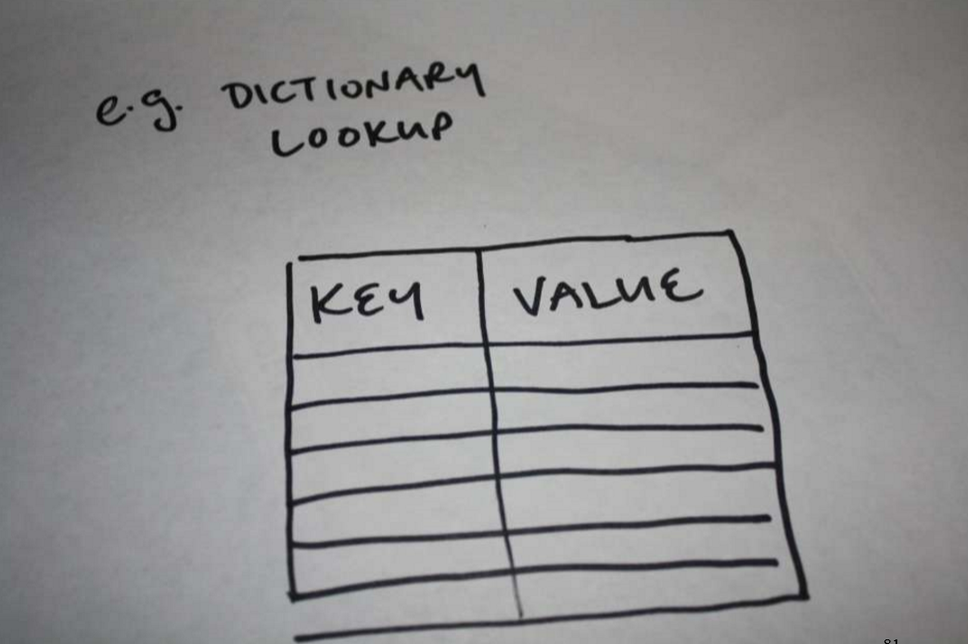

Slide 74
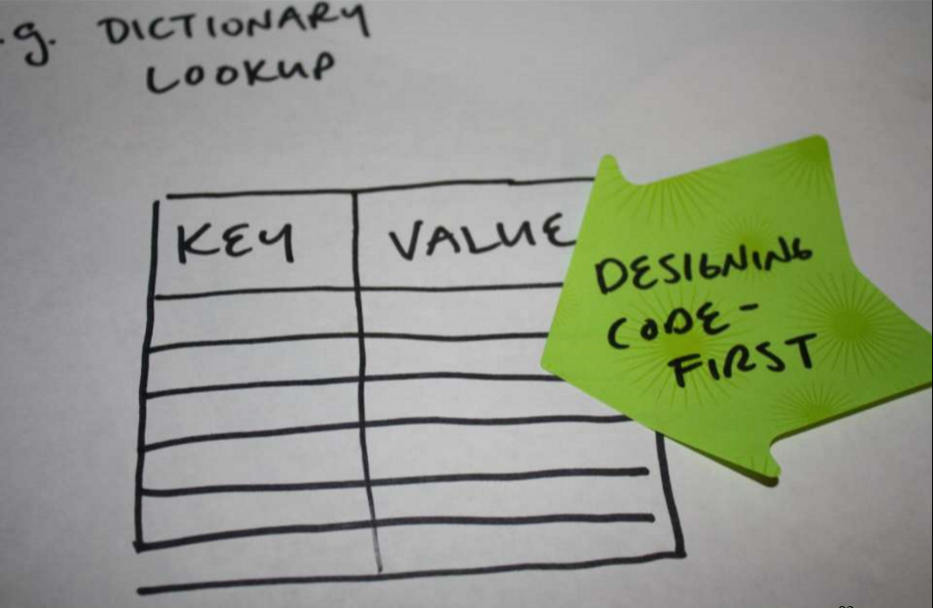

Slide 75
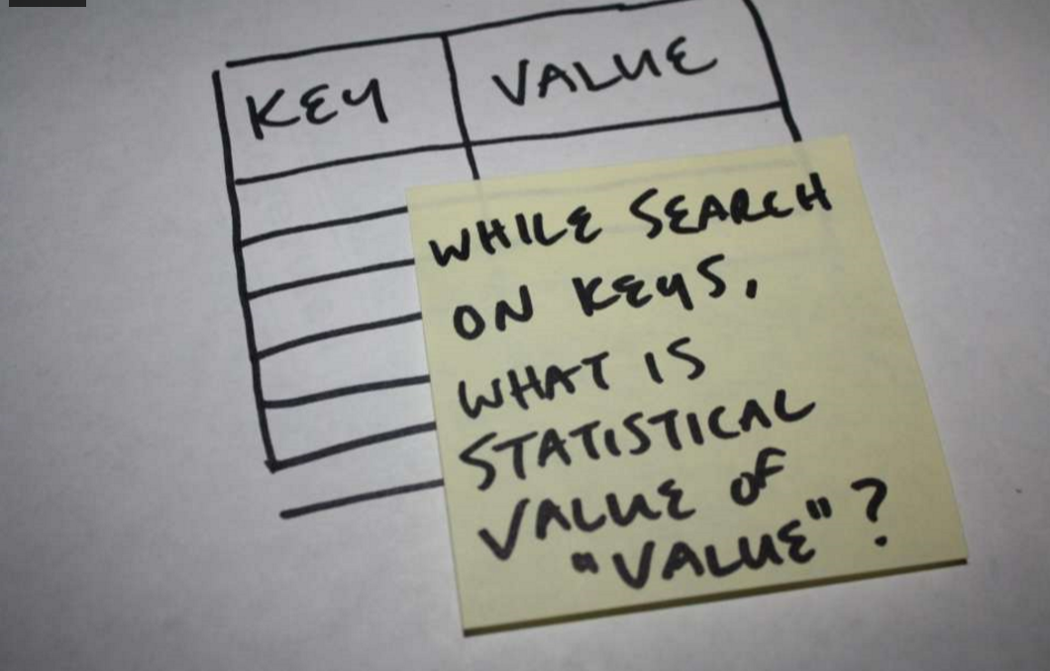

Slide 76
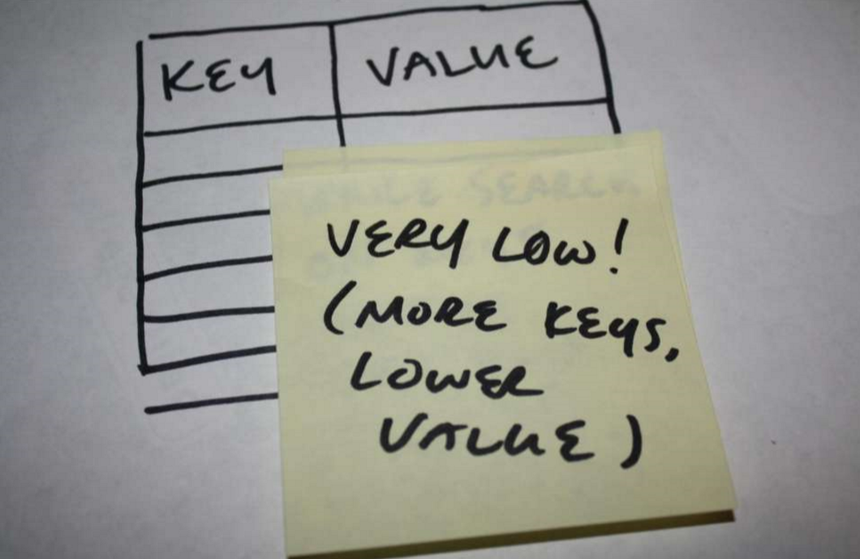

Slide 77
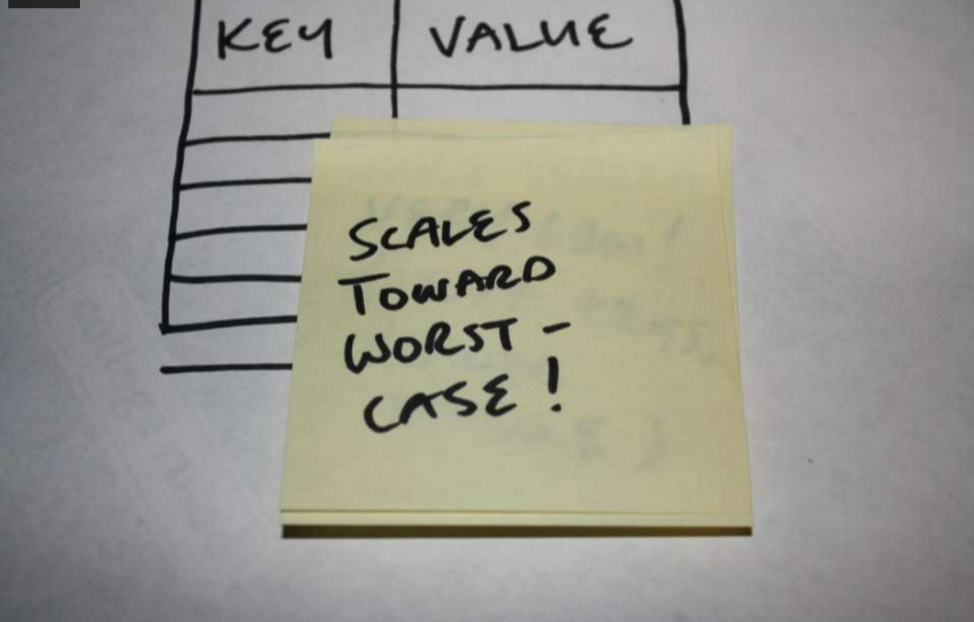

Slide 78
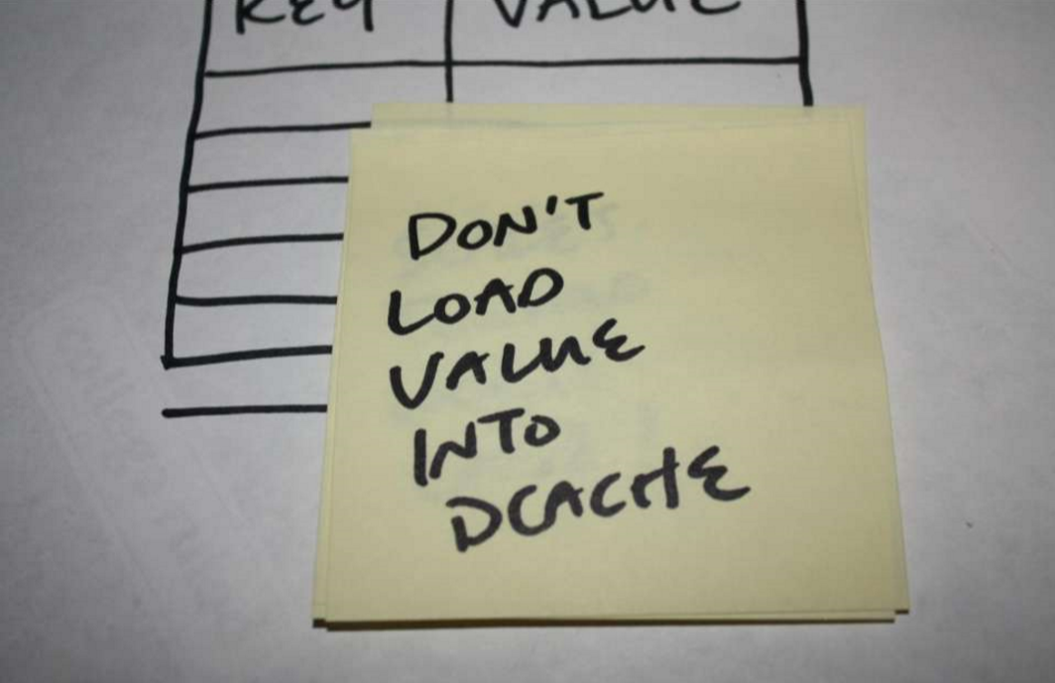

Slide 79
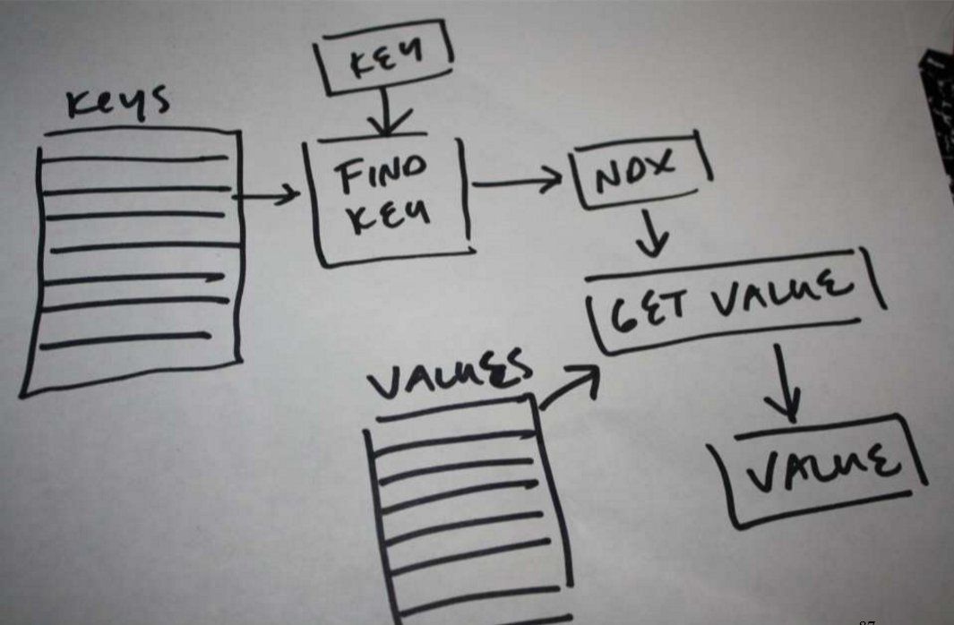

Slide 80
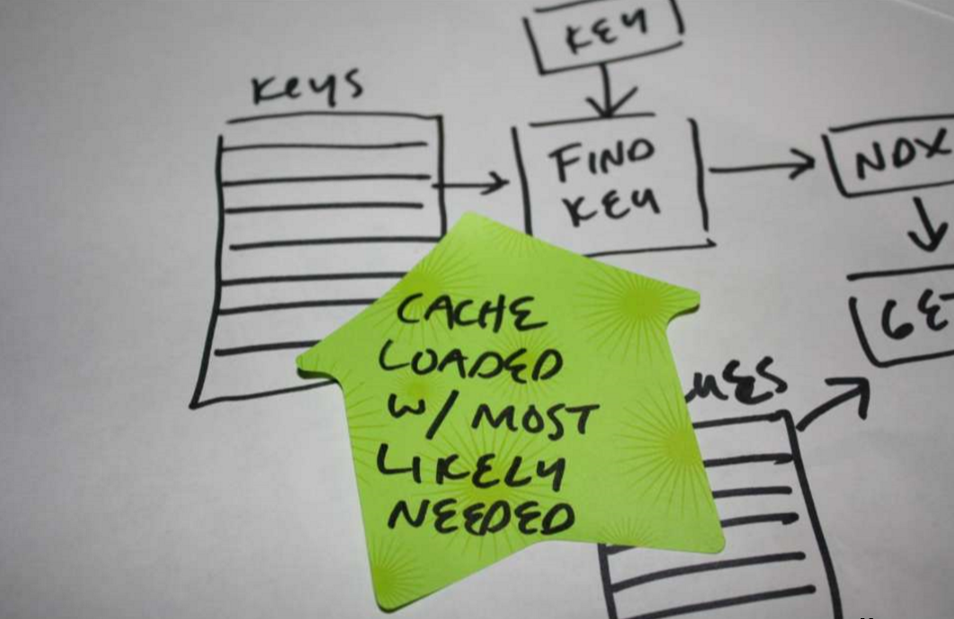

Slide 81
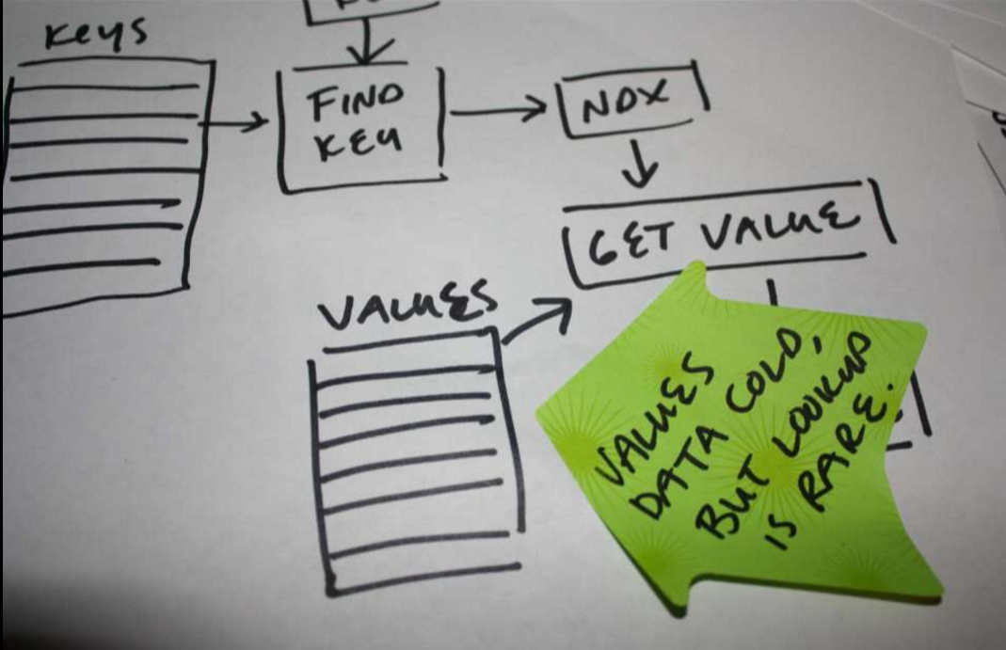

Slide 82
Solve for the most common case first,
Not the most generic.

Slide 83
“Can’t the compiler do it?”

Slide 84
A little review…

Slide 85
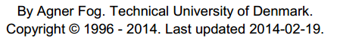
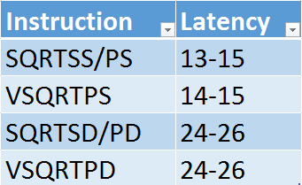
(AMD Piledriver)
http://www.agner.org/optimize/instruction_tables.pdf

Slide 86
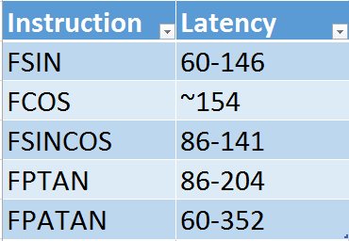
(AMD Piledriver)
http://www.agner.org/optimize/instruction_tables.pdf

Slide 87
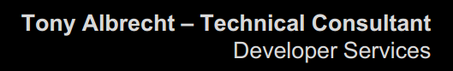
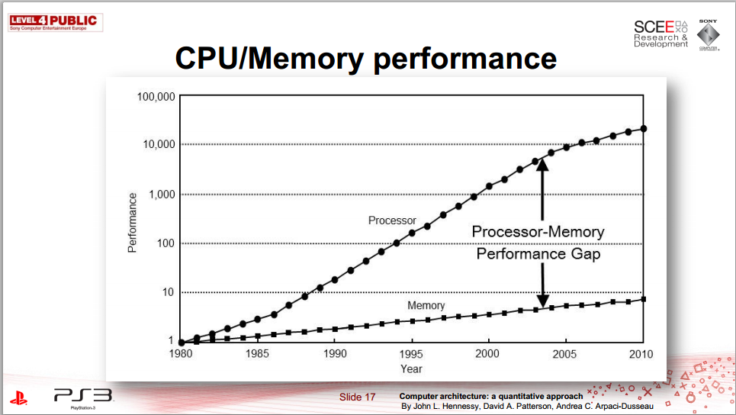
http://research.scee.net/files/presentations/gcapaustralia09/Pitfalls_of_Object_Oriented_Programming_GCAP_09.pdf

Slide 88
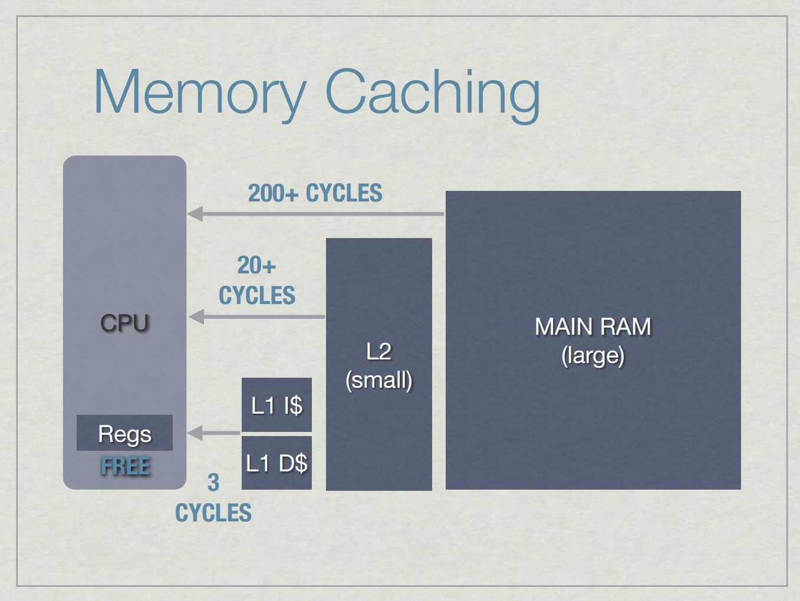
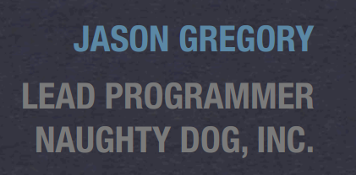
http://www.gameenginebook.com/SINFO.pdf

Slide 89

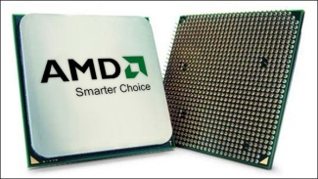
The Battle of North Bridge
L1
L2
RAM

Slide 90
L2 cache misses/frame
(Most significant component)

Slide 91
Not even including shared memory modes…
Name | GPU-visible |  | Cached | GPU Coherent
Heap-cacheable | No |  | Yes | No
Heap-write-combined | No |  | No | No
Physical-uncached | ? |  | No | No
GPU-write-combined | Yes |  | No | No
GPU-write-combined-read-only | Yes |  | No | No
GPU-cacheable | Yes |  | Yes | Yes
GPU-cacheable-noncoherent-RO | Yes |  | Yes | No
Command-write-combined | No |  | No | No
Command-cacheable | No |  | Yes | Yes

Slide 92
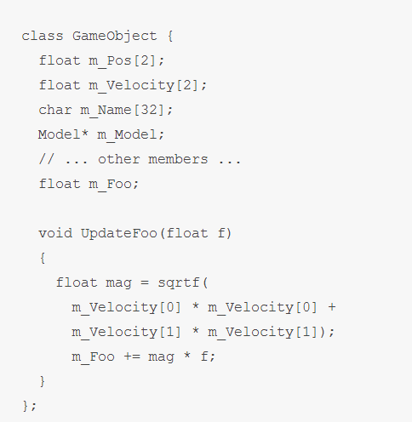
http://deplinenoise.wordpress.com/2013/12/28/optimizable-code/

Slide 93
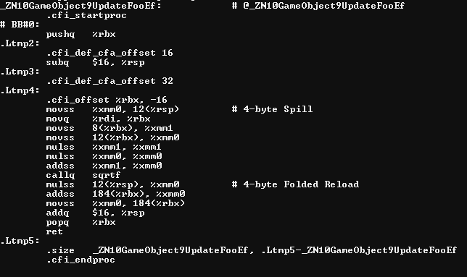

Slide 94
2 x 32bit read; same cache line = ~200

Slide 95
Float mul, add = ~10

Slide 96
Let’s assume callq is replaced. Sqrt = ~30

Slide 97
Mul back to same addr; in L1; = ~3

Slide 98
Read+add from new line
= ~200

Slide 99
Time spent waiting for L2 vs. actual work
~10:1

Slide 100
Time spent waiting for L2 vs. actual work
~10:1
This is the compiler’s space.

Slide 101

Time spent waiting for L2 vs. actual work
~10:1
This is the compiler’s space.

Slide 102
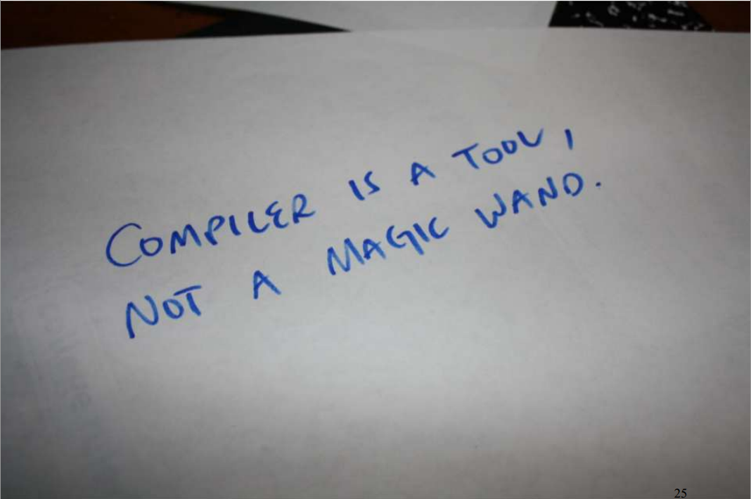
Compiler cannot solve the most significant problems.

Slide 103
Today’s subject: The 90% of problem space we need to solve that the compiler cannot.
(And how we can help it with the 10% that it can.)

Slide 104
Simple, obvious things to look for + Back of the envelope calculations = Substantial wins

Slide 105
L2 cache misses/frame
(Don’t waste them!)

Slide 106
Waste 56 bytes / 64 bytes

Slide 107
Waste 60 bytes / 64 bytes

Slide 108
90% waste!

Slide 109
Alternatively,
Only 10% capacity used*
* Not the same as “used well”, but we’ll start here.

Slide 110
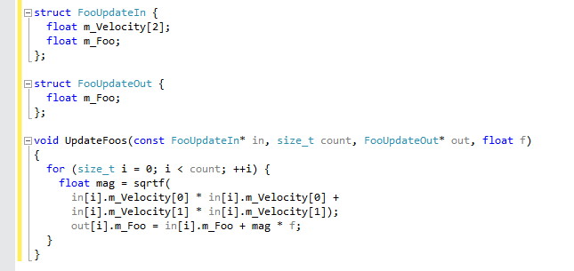

Slide 111
12 bytes x count(5) = 72

Slide 112
12 bytes x count(5) = 72
4 bytes x count(5) = 20

Slide 113
12 bytes x count(32) = 384 = 64 x 6
4 bytes x count(32) = 128 = 64 x 2

Slide 114
12 bytes x count(32) = 384 = 64 x 6
4 bytes x count(32) = 128 = 64 x 2
(6/32) = ~5.33 loop/cache line

Slide 115
12 bytes x count(32) = 384 = 64 x 6
4 bytes x count(32) = 128 = 64 x 2
(6/32) = ~5.33 loop/cache line
Sqrt + math = ~40 x 5.33 = 213.33 cycles/cache line

Slide 116
12 bytes x count(32) = 384 = 64 x 6
4 bytes x count(32) = 128 = 64 x 2
(6/32) = ~5.33 loop/cache line
Sqrt + math = ~40 x 5.33 = 213.33 cycles/cache line
+ streaming prefetch bonus

Slide 117
12 bytes x count(32) = 384 = 64 x 6
4 bytes x count(32) = 128 = 64 x 2
Using cache line to capacity* =
10x speedup
* Used. Still not necessarily as efficiently as possible
(6/32) = ~5.33 loop/cache line
Sqrt + math = ~40 x 5.33 = 213.33 cycles/cache line
+ streaming prefetch bonus

Slide 118
In addition…
Code is maintainable
Code is debugable
Can REASON about cost of change
(6/32) = ~5.33 loop/cache line
Sqrt + math = ~40 x 5.33 = 213.33 cycles/cache line
+ streaming prefetch bonus

Slide 119
In addition…
Code is maintainable
Code is debugable
Can REASON about cost of change
Ignoring inconvenient facts is not engineering;
It’s dogma.
(6/32) = ~5.33 loop/cache line
Sqrt + math = ~40 x 5.33 = 213.33 cycles/cache line
+ streaming prefetch bonus

Slide 120
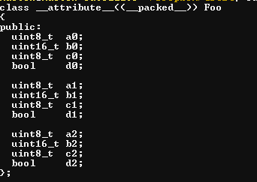
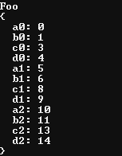
bools in structs…
(3) Extremely low information density

Slide 121
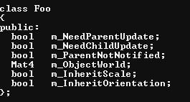
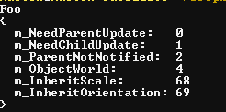
bools in structs…
(3) Extremely low information density
How big is your cache line?

Slide 122
bools in structs…
(3) Extremely low information density
How big is your cache line?
What’s the most commonly accessed data?
64b?

Slide 123
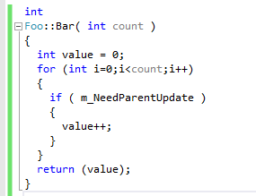
How is it used? What does it generate?
(2) Bools and last-minute decision making

Slide 124

MSVC

Slide 125
MSVC
Re-read and re-test…
Increment and loop…

Slide 126

Why?
Re-read and re-test…
Super-conservative aliasing rules…?
Member value might change?
Increment and loop…

Slide 127



What about something more aggressive…?

Slide 128
What about something more aggressive…?
Test once and return…

Slide 129

Okay, so what about…

Slide 130

…well at least it inlined it?

Slide 131

MSVC doesn’t fare any better…

Slide 132

(4) Ghost reads and writes
Don’t re-read member values or re-call functions when
you already have the data.

Slide 133

BAM!

Slide 134

:(

Slide 135

(4) Ghost reads and writes
Don’t re-read member values or re-call functions when
you already have the data.
Hoist all loop-invariant reads and branches. Even super- obvious ones that should already be in registers.

Slide 136

:)

Slide 137
:)
A bit of unnecessary branching, but more-or-less equivalent.

Slide 138
(4) Ghost reads and writes
Don’t re-read member values or re-call functions when
you already have the data.
Hoist all loop-invariant reads and branches. Even super- obvious ones that should already be in registers.
Applies to any member fields especially.
(Not particular to bools)

Slide 139

(3) Extremely low information density

Slide 140
(3) Extremely low information density
What is the information density for is_spawn
over time?

Slide 141

(3) Extremely low information density
What is the information density for is_spawn
over time?
The easy way.

Slide 142


Slide 143
Zip the output
10,000 frames
= 915 bytes
= (915*8)/10,000
= 0.732 bits/frame

Slide 144

Zip the output
10,000 frames
= 915 bytes
= (915*8)/10,000
= 0.732 bits/frame
Alternatively,
Calculate Shannon Entropy:

Slide 145
(3) Extremely low information density
What does that tell us?

Slide 146
(3) Extremely low information density
What does that tell us?
Figure (~2 L2 misses each frame ) x 10,000
If each cache line = 64b,
128b x 10,000 = 1,280,000 bytes

Slide 147
(3) Extremely low information density
What does that tell us?
Figure (~2 L2 misses each frame ) x 10,000
If each cache line = 64b,
128b x 10,000 = 1,280,000 bytes
If avg information content = 0.732bits/frame
X 10,000 = 7320 bits
/ 8 = 915 bytes

Slide 148

(3) Extremely low information density
What does that tell us?
Figure (~2 L2 misses each frame ) x 10,000
If each cache line = 64b,
128b x 10,000 = 1,280,000 bytes
If avg information content = 0.732bits/frame
X 10,000 = 7320 bits
/ 8 = 915 bytes
Percentage waste (Noise::Signal) =
(1,280,000-915)/1,280,000

Slide 149
What’re the alternatives?

Slide 150
(1) Per-frame…

Slide 151
(1) Per-frame…
(decision table)
1 of 512 (8*64) bits used…

Slide 152
(1) Per-frame…
(decision table)
1 of 512 (8*64) bits used…
(a) Make same decision x 512

Slide 153
(1) Per-frame…
(decision table)
1 of 512 (8*64) bits used…
(a) Make same decision x 512
(b) Combine with other reads / xforms

Slide 154
(1) Per-frame…
(decision table)
1 of 512 (8*64) bits used…
(a) Make same decision x 512
(b) Combine with other reads / xforms
Generally simplest.
But things cannot exist in abstract bubble.
Will require context.

Slide 155
(2) Over-frames…

Slide 156
(2) Over-frames…
i.e. Only read when needed

Slide 157


Arrays of command buffers for future frames…
(2) Over-frames…
i.e. Only read when needed
e.g.

Slide 158
Let’s review some code…

Slide 159


Slide 160


http://yosoygames.com.ar/wp/2013/11/on-mike-actons-review-of-ogrenode-cpp/

Slide 161


Slide 162
(1) Can’t re-arrange memory (much)
Limited by ABI
Can’t limit unused reads
Extra padding

Slide 163
(2) Bools and last-minute decision making

Slide 164
Are we done with the constructor?
(5) Over-generalization

Slide 165
Are we done with the constructor?
(5) Over-generalization
Complex constructors tend to imply that…
Reads are unmanaged (one at a time…)

Slide 166
Are we done with the constructor?
(5) Over-generalization
Complex constructors tend to imply that…
Reads are unmanaged (one at a time…)
Unnecessary reads/writes in destructors

Slide 167
Are we done with the constructor?
(5) Over-generalization
Complex constructors tend to imply that…
Reads are unmanaged (one at a time…)
Unnecessary reads/writes in destructors
Unmanaged icache (i.e. virtuals)
=> unmanaged reads/writes

Slide 168
Are we done with the constructor?
(5) Over-generalization
Complex constructors tend to imply that…
Reads are unmanaged (one at a time…)
Unnecessary reads/writes in destructors
Unmanaged icache (i.e. virtuals)
=> unmanaged reads/writes
Unnecessarily complex state machines (back to bools)
E.g. 2^7 states

Slide 169
Are we done with the constructor?
(5) Over-generalization
Complex constructors tend to imply that…
Reads are unmanaged (one at a time…)
Unnecessary reads/writes in destructors
Unmanaged icache (i.e. virtuals)
=> unmanaged reads/writes
Unnecessarily complex state machines (back to bools)
E.g. 2^7 states
Rule of thumb:
Store each state type separately
Store same states together
(No state value needed)

Slide 170
Are we done with the constructor?
(5) Over-generalization
(6) Undefined or under-defined constraints

Slide 171
Are we done with the constructor?
(5) Over-generalization
(6) Undefined or under-defined constraints
Imply more (wasted) reads because pretending you
don’t know what it could be.

Slide 172
Are we done with the constructor?
(5) Over-generalization
(6) Undefined or under-defined constraints
Imply more (wasted) reads because pretending you
don’t know what it could be.
e.g. Strings, generally. Filenames, in particular.

Slide 173
Are we done with the constructor?
(5) Over-generalization
(6) Undefined or under-defined constraints
Imply more (wasted) reads because pretending you
don’t know what it could be.
e.g. Strings, generally. Filenames, in particular.
Rule of thumb:
The best code is code that doesn’t need to exist.
Do it offline. Do it once.
e.g. precompiled string hashes

Slide 174
Are we done with the constructor?
(5) Over-generalization
(6) Undefined or under-defined constraints
(7) Over-solving (computing too much)
Compiler doesn’t have enough context to know
how to simplify your problems for you.

Slide 175
Are we done with the constructor?
(5) Over-generalization
(6) Undefined or under-defined constraints
(7) Over-solving (computing too much)
Compiler doesn’t have enough context to know
how to simplify your problems for you.
But you can make simple tools that do…
E.g. Premultiply matrices

Slide 176
Are we done with the constructor?
(5) Over-generalization
(6) Undefined or under-defined constraints
(7) Over-solving (computing too much)
Compiler doesn’t have enough context to know
how to simplify your problems for you.
But you can make simple tools that do…
E.g. Premultiply matrices
Work with the (actual) data you have.
E.g. Sparse or affine matrices

Slide 177
How do we approach “fixing” it?

Slide 178


Slide 179
(2) Bools and last-minute decision making

Slide 180

Step 1: organize
Separate states so you can reason about them

Slide 181
Step 1: organize
Separate states so you can reason about them
Step 2: triage
What are the relative values of each case
i.e. p(call) * count

Slide 182

Step 1: organize
Separate states so you can reason about them
Step 2: triage
What are the relative values of each case
i.e. p(call) * count
e.g. in-game vs. in-editor

Slide 183
Step 1: organize
Separate states so you can reason about them
Step 2: triage
What are the relative values of each case
i.e. p(call) * count
Step 3: reduce waste

Slide 184

(back of the envelope read cost)
~200 cycles x 2 x count

Slide 185

(back of the envelope read cost)
~200 cycles x 2 x count
~2.28 count per 200 cycles
= ~88

Slide 186
(back of the envelope read cost)
~200 cycles x 2 x count
~2.28 count per 200 cycles
= ~88
t = 2 * cross(q.xyz, v)
v' = v + q.w * t + cross(q.xyz, t)

Slide 187
(back of the envelope read cost)
~200 cycles x 2 x count
~2.28 count per 200 cycles
= ~88
(close enough to dig in and
measure)
t = 2 * cross(q.xyz, v)
v' = v + q.w * t + cross(q.xyz, t)

Slide 188

Apply the same steps recursively…

Slide 189
Apply the same steps recursively…
Step 1: organize
Separate states so you can reason about them
Root or not; Calling function with context can distinguish

Slide 190
Apply the same steps recursively…
Step 1: organize
Separate states so you can reason about them
Root or not; Calling function with context can distinguish

Slide 191

Apply the same steps recursively…
Step 1: organize
Separate states so you can reason about them

Slide 192
Apply the same steps recursively…
Step 1: organize
Separate states so you can reason about them
Can’t reason well about the cost from…

Slide 193

Step 1: organize
Separate states so you can reason about them

Slide 194
Step 1: organize
Separate states so you can reason about them
Step 2: triage
What are the relative values of each case
i.e. p(call) * count
Step 3: reduce waste

Slide 195
Good News: Most problems are easy to see.

Slide 196
Good News: Side-effect of solving the 90% well, compiler can solve the 10% better.

Slide 197
Good News: Organized data makes maintenance, debugging and concurrency much easier

Slide 198
Bad News: Good programming is hard. Bad programming is easy.

Slide 199


While we’re on the subject…
DESIGN PATTERNS:
“
http://realtimecollisiondetection.net/blog/?p=81
http://realtimecollisiondetection.net/blog/?p=44

Slide 200


Slide 201


